Slide 1
Chapter 1
Introduction
By: Arjun Singh Saud
Lecturer, CDCSIT, TU

Slide 2
What is Intelligence?
What is intelligence? This is a complex question with no well-defined answer.
One could certainly define intelligence by the properties it exhibits: an ability to deal with new situations; the ability to solve problems, to answer questions, to devise plans, and so on.

Slide 3
What is AI?
According to the father of Artificial Intelligence, John McCarthy, it is “The science and engineering of making intelligent machines, especially intelligent computer programs”.
Artificial Intelligence is a way of making a computer, a computer-controlled robot, or software that behaves intelligently, in the similar manner the intelligent humans behaves.

Slide 4
AI Perspectives
Since Artificial Intelligence is a vast topic, embodying the knowledge of many domains of science, it’s definition has evolved rapidly in the recent years.
The various definitions have been grouped into 4 different dimensions or schools of thoughts.

Slide 5
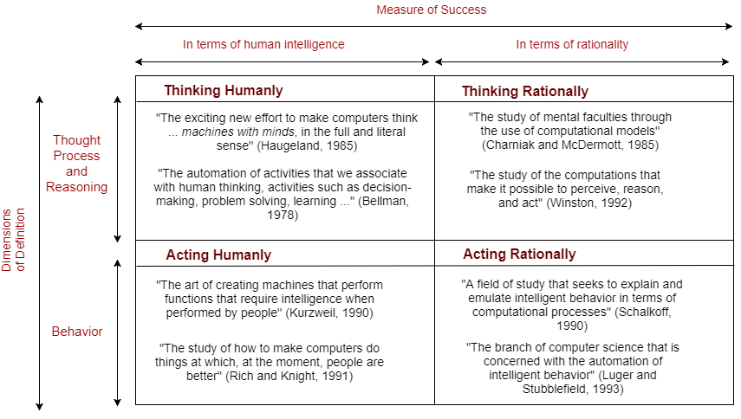
AI Perspectives

Slide 6
Thinking Humanly: Cognitive modeling approach
Make the machines with mind. To make a machine that think like human brain, scientific theories of internal brain activities (cognitive model) are required. Two ways of doing this is:
Predicting and testing human behavior (cognitive science)
Identification from neurological data (Cognitive neuroscience)
Once we have precise theory of mind, it is possible to express the theory as a computer program.

Slide 7
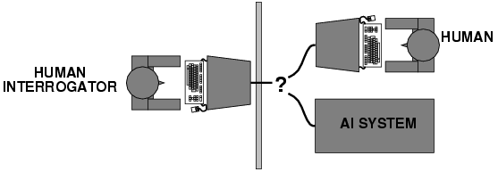
Acting Humanly: The Turing Test Approach
To pass a Turing test, a computer must have following capabilities:
Natural Language Processing
Knowledge representation
Automated reasoning
Machine learning
To pass the total Turing test computer must have following additional capabilities:
Computer Vision
Robotics

Slide 8
Thinking Rationally: The Laws of Thought Approach
Rationality means right thinking that is irrefutable reasoning process. Aristotle gave Syllogisms that always yielded correct conclusion when correct premises are given. For example:
Ram is a man
Man is mortal Modus Ponens
Therefore Ram is mortal
This study initiated the field of logic. The logicist tradition in AI hopes to create intelligent systems using logic programming.

Slide 9
Acting Rationally: The Rational Agent Approach
Agent is something that acts. Computer agent is expected to have following attributes: Autonomous control, Perceiving their environment, Persisting over a prolonged period of time, Adapting to change, And capable of taking on another’s goal
Rational behavior means doing the right thing. Rational Agent is one that acts so as to achieve the best outcome. One way to act rationally is to reason logically to the conclusion and act on that conclusion. On the other hand there are also some ways of acting rationally that can not be said to involve inference. For Example, reflex action

Slide 10
History of AI
In the summer of 1956, scientists gather for a conference at Dartmouth College. They believe that human intelligence can be simulated by machines. The programmer John McCarthy proposes calling this Artificial Intelligence.
Allen Newell, and Herbert Simon revealed a program Logic Theorist (LT) during the conference. LT was capable of proving elementary theorems in the propositional calculus.

Slide 11
History of AI
The General Problem Solver (GPS) was demonstrated by Newell, Shaw & Simon in 1959. Any problem that can be expressed as a set of well-formed formulas (WFFs) clauses can be solved by GPS.
The German-American computer scientist Joseph Weizenbaum of the Massachusetts Institute of Technology (MIT) invents a computer program named ELIZA in 1966 that communicates with humans.

Slide 12
History of AI
With MYCIN (1972), Artificial Intelligence finds its way into medical practices. It was the expert system developed by Ted Shortliffe at Stanford University and is used for the treatment of illnesses.
Terrence J. Sejnowski and Charles Rosenberg has written a computer program named NETtalk in 1986 that can be taught to speak by inputting sample sentences and phoneme chains. NETtalk is able to read words and pronounce them correctly, and can apply what it has learned to words it does not know.

Slide 13
History of AI
In 1997, the AI chess computer named Deep Blue from IBM defeats the chess world champion Garry Kasparov in a tournament. This is considered a historic success in an area previously dominated by humans.
Powerful processors and graphics cards in computers, smartphones, and tablets give regular consumers access to AI programs. Digital assistants in particular enjoy great popularity: Apple’s Siri comes to the market in 2011, Microsoft introduces the Cortana software in 2014, and Amazon presents Amazon Echo with the voice service Alexa in 2015.

Slide 14
History of AI
The computer program Watson competes in a U.S. television quiz show jeopardy challenge in 2011 and wins against the human players.
Project Debater from IBM debated complex topics with two master debaters and performed remarkably well in 2018.
Decades of research notwithstanding, artificial intelligence is comparatively still in its infancy. It needs to become more reliable and secure against manipulation before it can be used in sensitive areas

Slide 15
Foundations of AI
Artificial intelligence has identifiable roots in number of older disciplines such as Philosophy, Psychology, Mathematics, Economics, Neuroscience, Computer Science etc. These are the areas that have contributed and can contribute more to build an intelligent system.

Slide 16
Foundations of AI
Philosophy
It is the area of study concerned with knowledge, thinking, reasoning, mind etc., understanding of these concepts are really helpful in making intelligent machines. Some of the representative studies in philosophy that has contributed AI are presented below:
Aristotle developed an informal system of syllogisms for proper reasoning.
Thomas Hobbes proposed that reasoning was like numerical computation. Thus, artificial animal is not implausible.
Empiricism in philosophy defines a mathematical procedure for extracting beliefs from experience.

Slide 17
Foundations of AI
Psychology
Modern Psychology, also called Cognitive Psychology is the science which studies how the mind operates, how we behave, and how our brains process information. Followings are the key points from researches in cognitive psychology that has contributed Artificial Intelligence.
At the MIT workshop (1956), Noam Chomsky presented Three Models of Language, and Newell and Simon presented The Logic Theory Machine. These papers showed how computer models could be used to address the psychology of memory, language, and logical thinking, respectively.
It is now a common view among psychologists that "a cognitive theory should be like a computer program. That is, it should describe a detailed information-processing mechanism.

Slide 18
Foundations of AI
Mathematics
AI is formal science and hence requires a level of mathematical formalization in three fundamental areas: logic, computation, and probability. Some of the key facts that show contribution of mathematics in AI are presented below.
Aristotle invented concept of formal logic (deductive reasoning), which was much improved by George Boole and especially Gottlob Frege
Kurt Godel’s incompleteness theorem showed that there are limits on what can be computed.
Bays Rule, which is used widely in AI for uncertain reasoning, is developed by Thomas Bayes, Pierre Laplace, and others.

Slide 19
Foundations of AI
Economics
There are many theories and concepts, originally from economics, which are widely used in the field of Artificial Intelligence. Some of the key theories from economics used in AI are presented below.
Game theory and Decision Theory, which provide a framework for making decisions under a state of uncertainty and widely used in AI.
How to make rational decisions when payoffs come only after a series of actions? That topic is discussed in Operations Research, and led to the discovery of Markov decision process and other advances.

Slide 20
Foundations of AI
Neuroscience
Neuroscience is a multidisciplinary science that is concerned with the study of the structure and function of the nervous system. Some of the important contributions in AI that are motivated from neuroscience are presented below.
Donald Hebb studied how the neurons contributed to psychological processes such as learning. He is best known for his theory of Hebbian Learning.
Along with Walter Pitts, McCulloch created computational models based on biological processes in the brain.

Slide 21
Foundations of AI
Computer Science
For artificial intelligence to succeed, we need two things: intelligence and an artifact. The computer has been the artifact of choice. Key contributions from computer science to AI are listed below.
Since that time, each generation of computer hardware has brought an increase in speed and capacity and a decrease in price. Current expectations are that future increases in power will come from massive parallelism—a curious convergence with the properties of the brain
AI also owes a debt to the software side of computer science, which has supplied the operating systems, programming languages, and tools needed to write modern programs.

Slide 22
Applications of AI
Game Playing
AI plays crucial role in playing games such as chess, poker, tic-tac-toe, etc. By using AI techniques machine can think large number of possible moves based on heuristic knowledge. For example, we can buy machines that can play master level chess for a few hundred dollars.

Slide 23
Applications of AI
Speech Recognition
Some intelligent systems are capable of hearing and comprehending the language in terms of sentences and their meanings while a human talks to it. It can handle different accents, slang words, noise in the background, change in human’s noise due to cold etc. For example, Siri is an Apple App that lets us stay connected without lifting a finger. We can interact with Siri through voice message like “Hey Siri, call Mom on speaker”, “Text Rabin I am on the way” so on.

Slide 24
Applications of AI
Natural Language Processing (NLP)
Natural Language Processing (NLP) refers to AI method of communicating with intelligent systems using a natural language such as English or Nepali. The input and output of an NLP system can be Speech or Written Text. Neural Text-to-Speech is a system created by Microsoft that uses deep neural networks to make the voices of computers nearly indistinguishable for recordings of real people.

Slide 25
Applications of AI
Computer Vision
Computer vision is a term that depicts the capability of a machine to get and analyze visual information. It is the science and technology of machines that see. A significant part of artificial intelligence deals with planning for system which can perform mechanical actions such as moving a robot through some environment. This type of processing typically needs input data provided by a computer vision system.

Slide 26
Applications of AI
Expert Systems
A knowledge engineer interviews experts in a certain domain and embodies their knowledge in a computer program. Such systems or programs are called expert system. One of the first expert systems was MYCIN, which diagnosed bacterial infections of the blood and suggested treatments. It did better than medical students or practicing doctors, provided its limitations were observed.

Slide 27
Applications of AI
Heuristic Classification
Expert systems normally give only present knowledge. But, sometimes AI systems need to have several sources of information. The technique used for such task is called Heuristic Classification. An example is advising whether to accept a proposed credit card purchase. Information is available about the owner of the credit card, his record of payment etc.

